Slide 1
SECURE DATA HIDING IN IMAGES USING STEGANOGRAPHY
CAPSTONE PROJECT
Presented By
Student Name : Harshal Jagdish Mahajan
College Name & Department : R. C. Patel Institute Of Technology
& CSE in Data Science

Slide 2
OUTLINE
Problem Statement
Technology used
Wow factor
End users
Result
Conclusion
Git-hub Link
Future scope

Slide 3
Problem Statement
With increasing cyber threats, secure communication is essential to protect sensitive information. Traditional encryption methods can be detected easily, making them vulnerable to attacks. This project implements steganography to hide secret messages within images, ensuring covert and secure data transmission.

Slide 4
Technology used
Platforms: Google Colab
Libraries Used: cv2 (Opencv), os, string

Slide 5
Wow factors
Invisible data embedding (No noticeable changes in the image)
High security: Even if intercepted, extraction is difficult without the key
Low impact on image quality (maintains original resolution)
Can be used for secure communication, watermarking, and copyright protection

Slide 6
End users
Government Agencies (Secure message transmission)
Journalists & Activists (Secure data sharing)
Cybersecurity Experts (Covert data exchange)
Banking & Finance (Fraud detection and secure transactions)
Healthcare (Medical record protection)

Slide 7
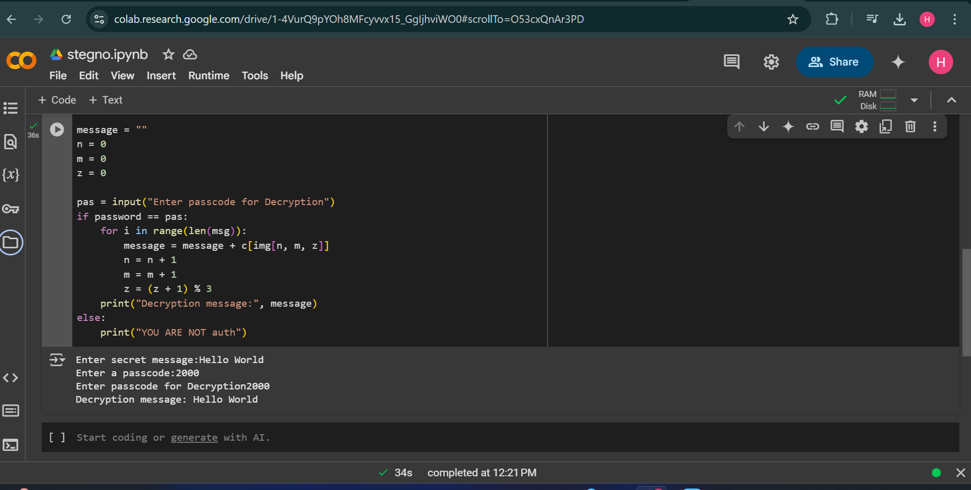
Results

Slide 8
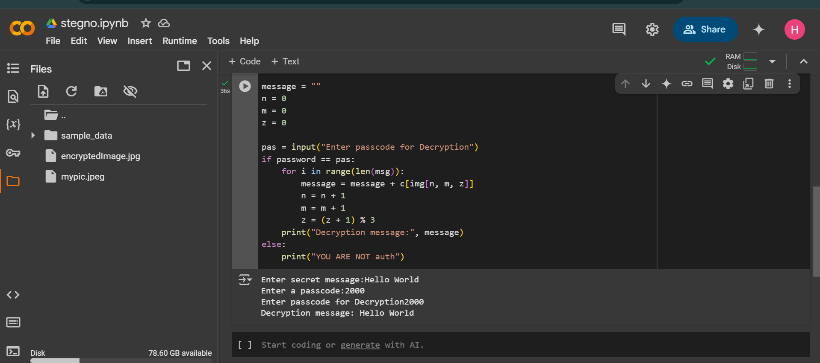

Slide 9
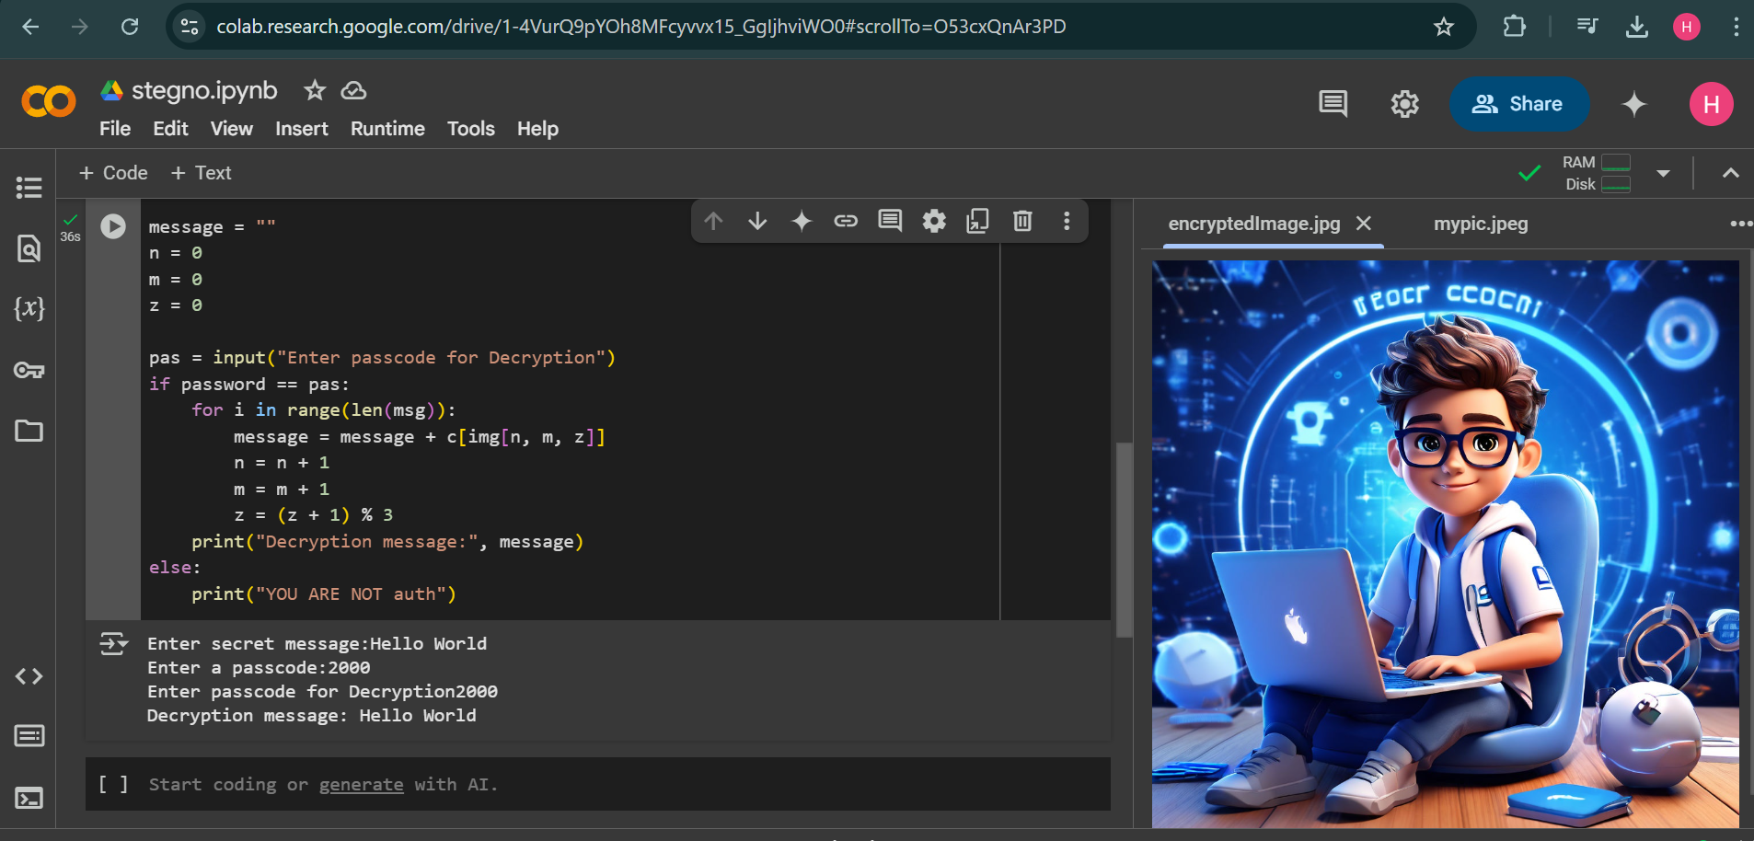

Slide 10
Conclusion
Steganography provides an effective way to hide data securely in images.
With proper implementation, it ensures undetectable communication and data protection.
Combining with encryption further enhances security.

Slide 11
GitHub Link
https://github.com/MahajanHarshal28/Stenography

Slide 12
Future scope
AI-powered Steganography (Intelligent hiding techniques)
Quantum Computing & Cryptography Integration
Multimedia Steganography (Hiding data in videos, audio, and GIFs)
Blockchain-based Steganography for tamper-proof secure communication
Mobile App Development (Steganography tools for Android & iOS)

Slide 13
THANK YOU

